Slide 1

PWM DRAWER
AMIT - Graduation Project

Slide 2
TABLE OF CONTENTS
01
02
03
04
INTRODUCTION
LAYERED ARCHITECTURE
STEPS OF THE PROJECT
ASSEMBLY

Slide 3
01
INTRODUCTION

Slide 4
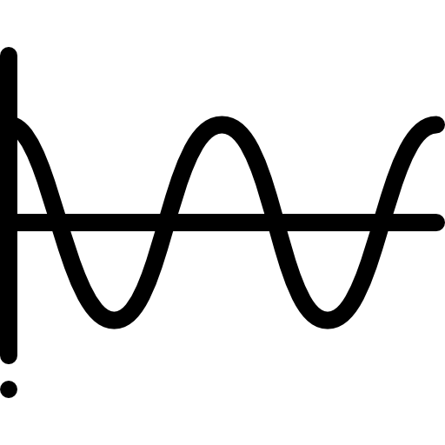
01 - INTRODUCTION
Pulse width modulation is an effective technique that is used to control semiconductor devices. Pulse width modulation or PWM is a commonly used control technique that generates analog signals from digital devices such as microcontrollers. The signal thus produced will have a train of pulses, and these pulses will be in the form of square waves. Thus, at any given time, the wave will either be high or low.

Slide 5
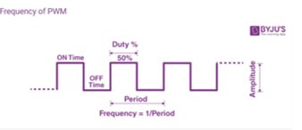
Parameters of PWM
Duty factor
Frequency
Time on/ Total period
1/Period

Slide 6
02
LAYERED ARCHITECTURE

Slide 7

1

Slide 8

03
STEPS OF THE PROJECT

Slide 9
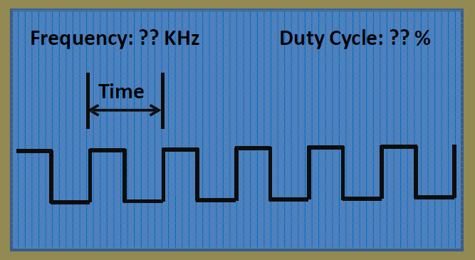
GRAPHICAL SPECIFICATIONS OF THE LCD
The following can be shown on the graphical LCD:
The PWM shape, whether it was generated internally or from sources outside.
The generated wave's frequency, which is displayed in KHz on the LCD's upper left side.
The generated wave duty cycle, which is displayed on the LCD's upper right side.
The duration of one cycle.

Slide 10
METHODOLOGY
01
02
03
OPERATION
ALGORITHM
FLOWCHART

Slide 11

01- ALGORITHM
Started by planning the project by writing paper algorithms, and writing down the needed modules, and functions.
Did a research on PWM and watched similar projects
Used the datasheet to know the function of each register, pin and port, to know which ones to use.

Slide 12

02- OPERATION
Collected the DIO, Timer, and LCD modules we wrote in the course
Write the LCD functions and define each pin
Write the PWM function that calculates the frequency and the duty cycle and update the value on the LCD
Write the PWM Drawer function that draws wave
Check for errors and debug
Flash the project on the microcontroller

Slide 13
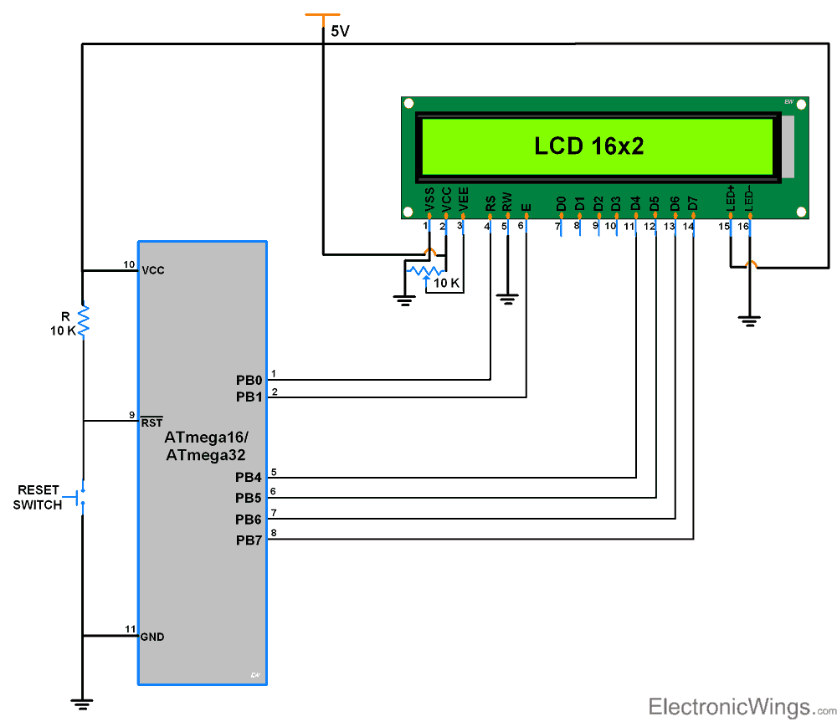
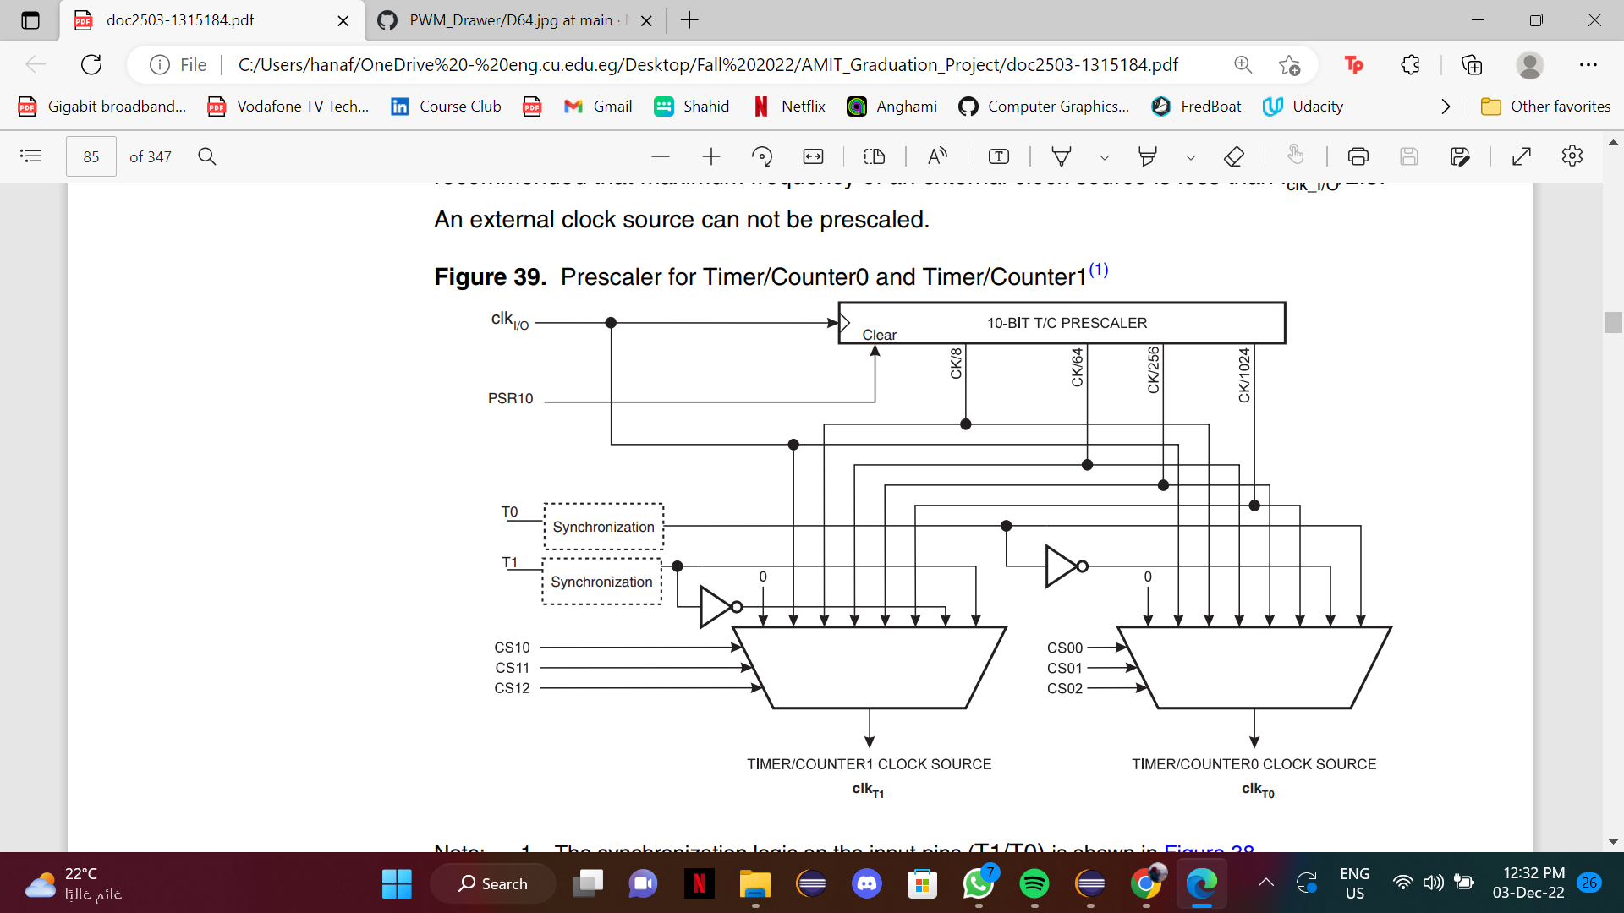
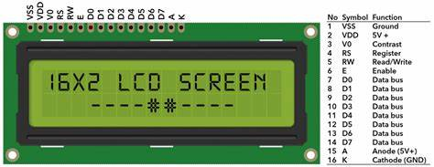
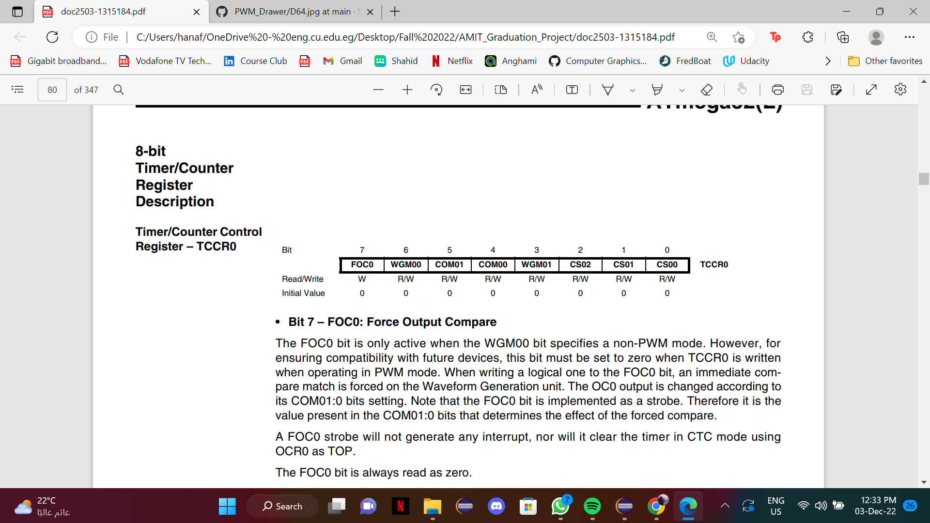
Basic Concept
STEP 1
STEP 2
LCD
Timer

Slide 14
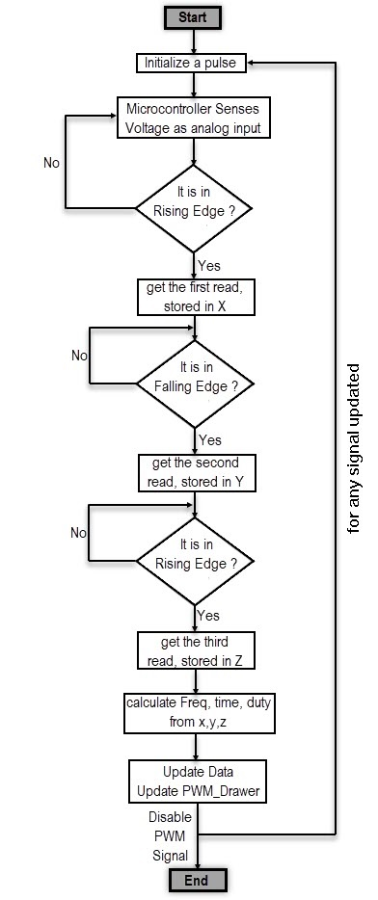
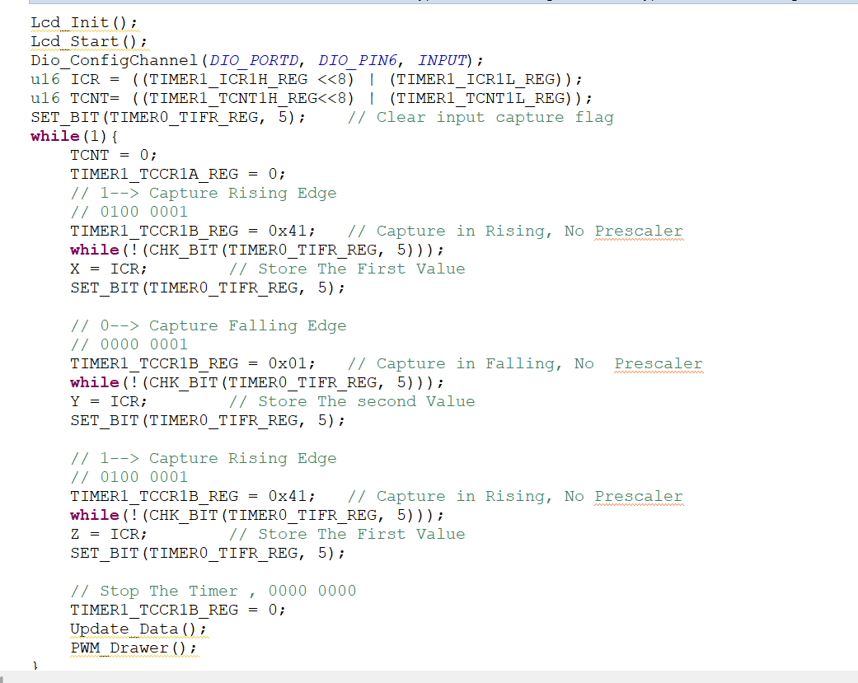
03- FLOWCHART

Slide 15
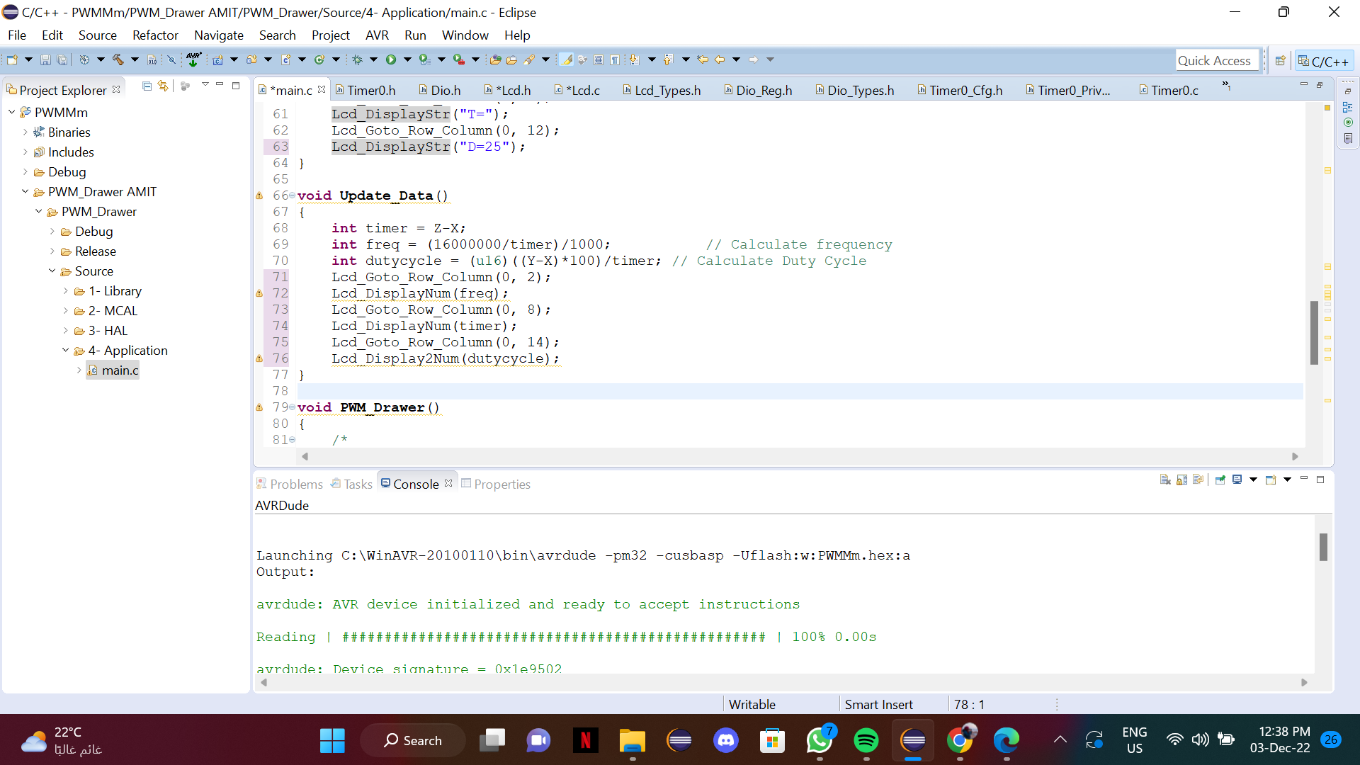
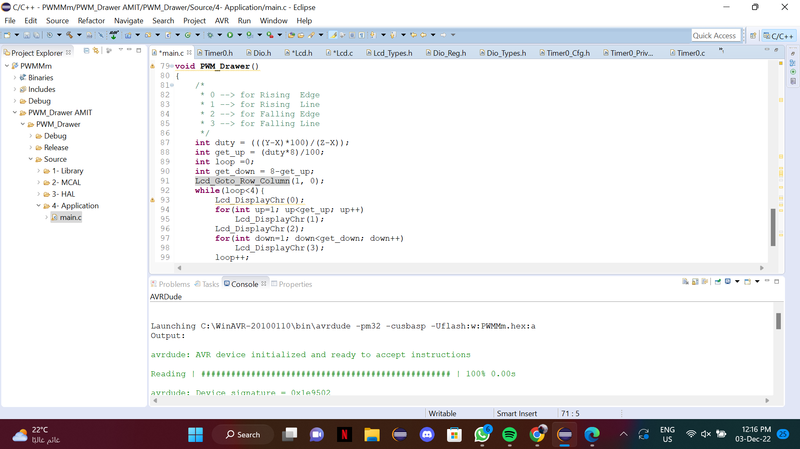
Calculate the parameters & update data
Update PWM Drawer

Slide 16

04
ASSEMBLY

Slide 17
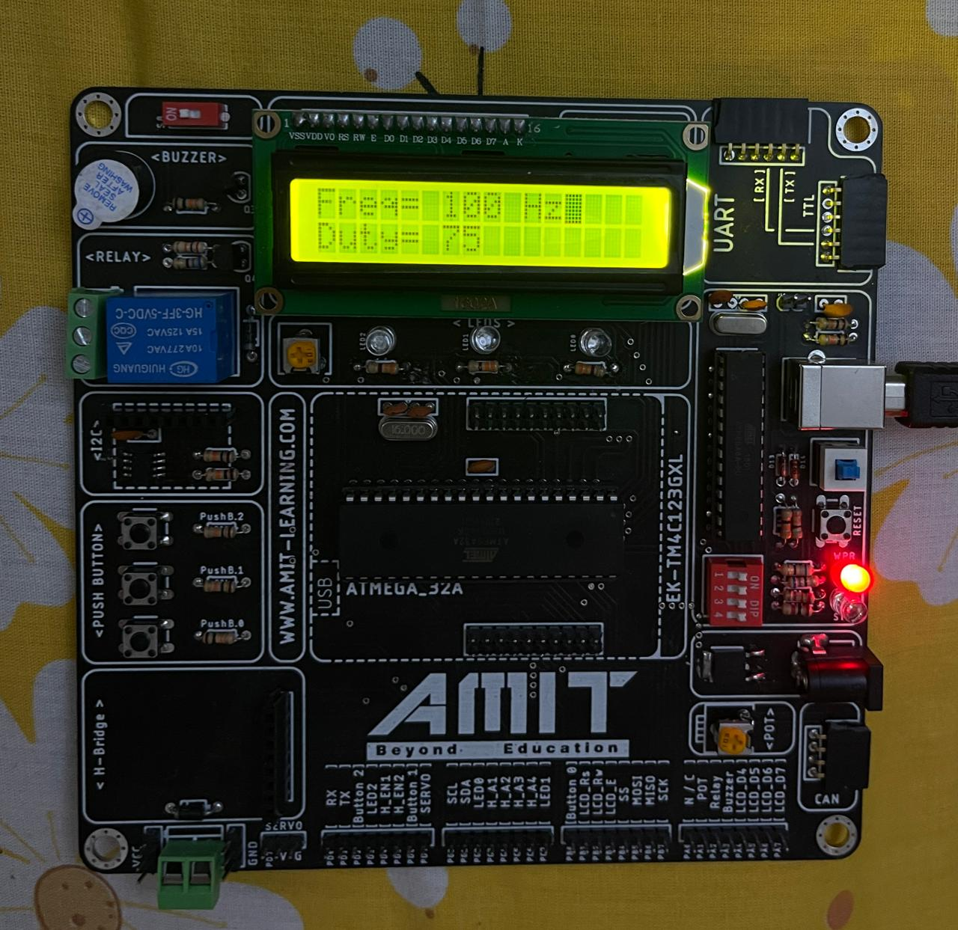
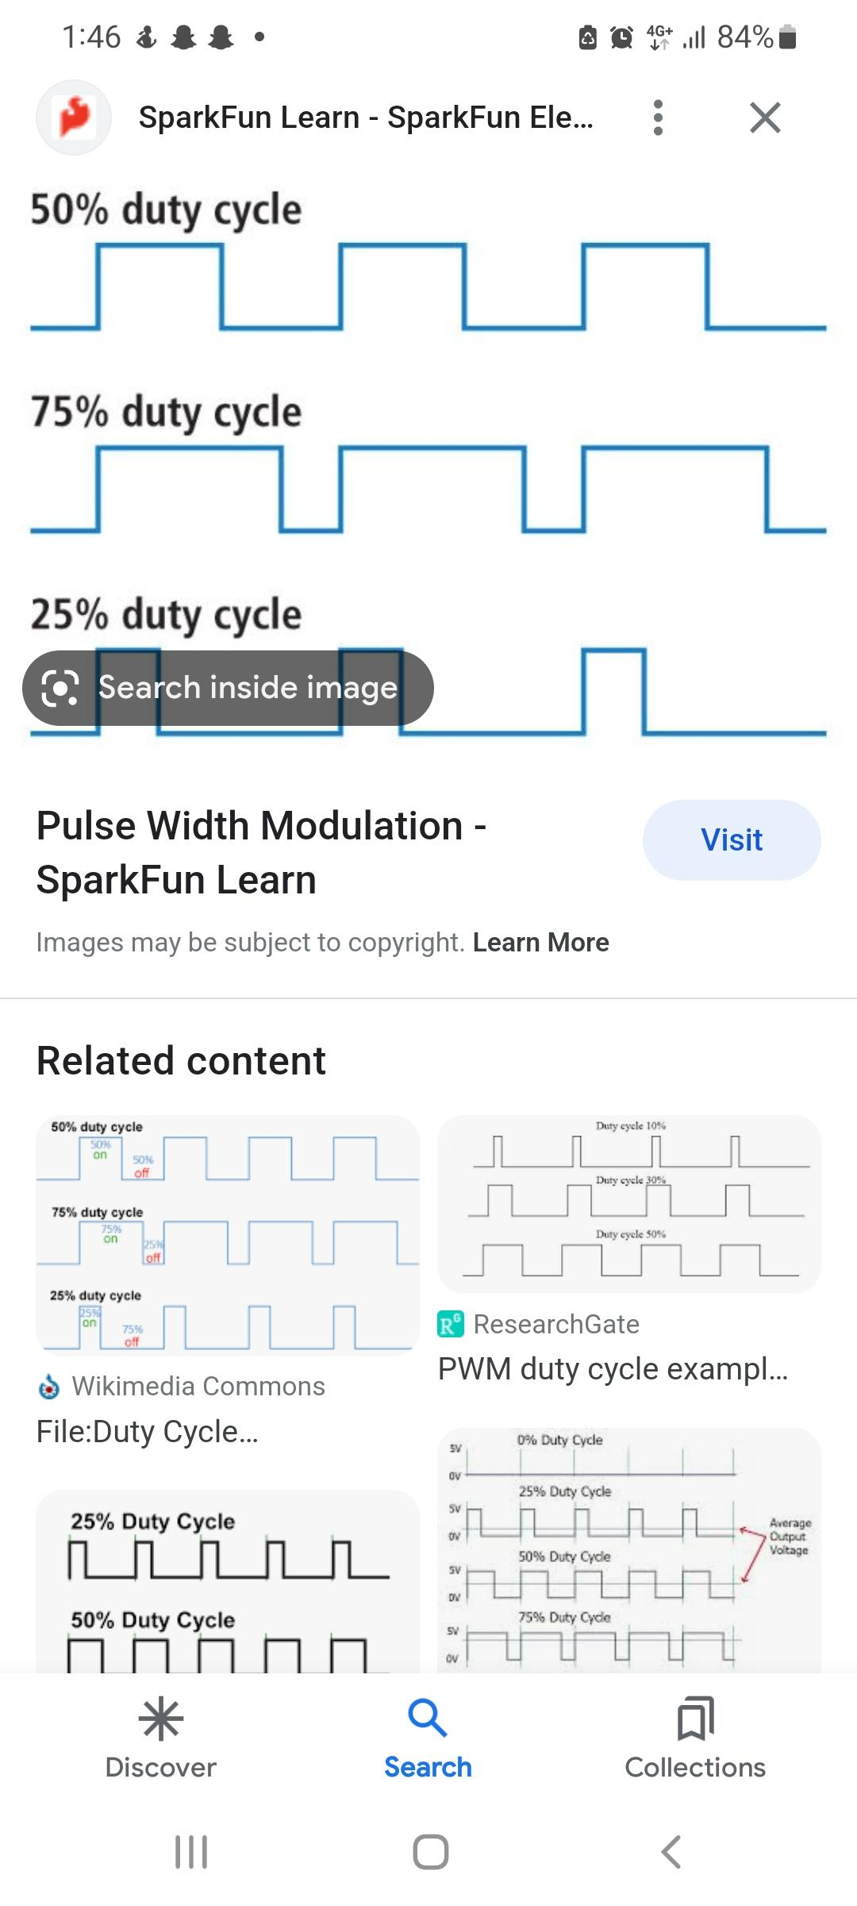
PHOTOS
At first I could not draw the wave, so I displayed the values of the duty and frequency

Slide 18
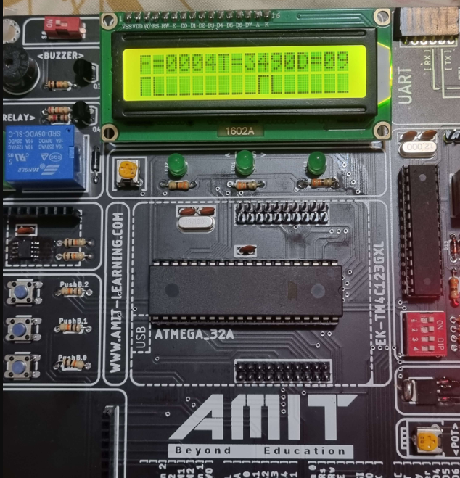
Final output
Added Timer1 to capture the falling and rising edges and draw the waveform.

Slide 19




THANKS!
Do you have any questions?

